Slide 1
Topics modeling over time
Laura Tolosi-Halacheva
June 2024

Slide 2
Usecase
Medical affairs department
Receive many calls from patients, doctors and pharmacists
They ask about our products, report issues, side effects
They are world-wide, multilingual
They are VERY IMPORTANT, if issues are overlooked, the company can go out of business
Can we discover what people are talking about?
Common topics
Emerging topics
Important/ critical topics
We cannot search for something that we don’t know exists as topic of discussion

Slide 3
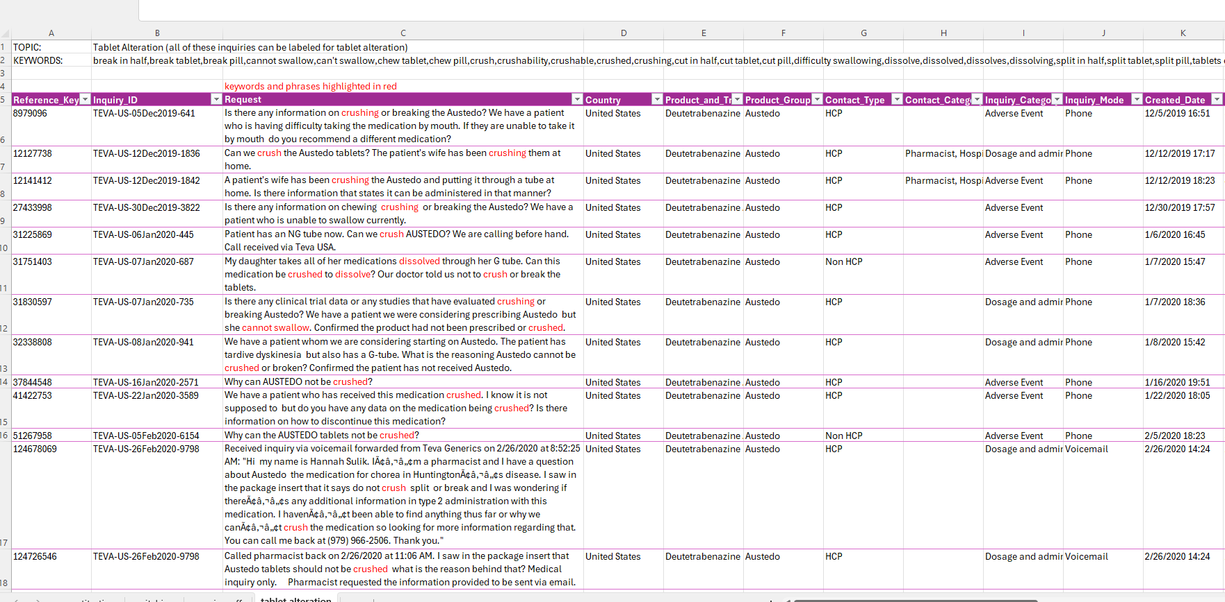
Usecase

Slide 4
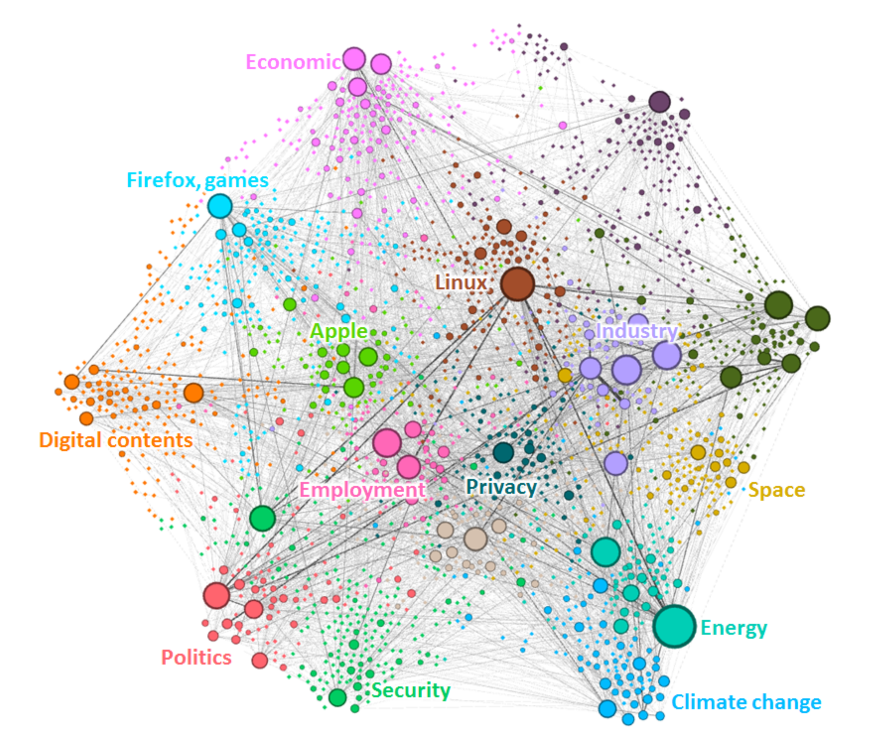
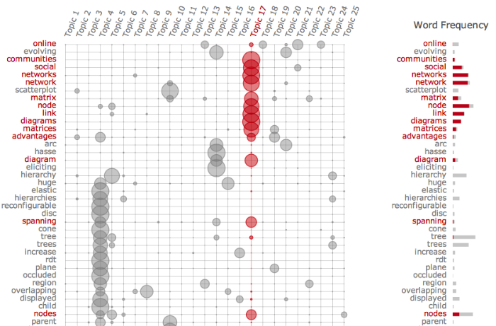
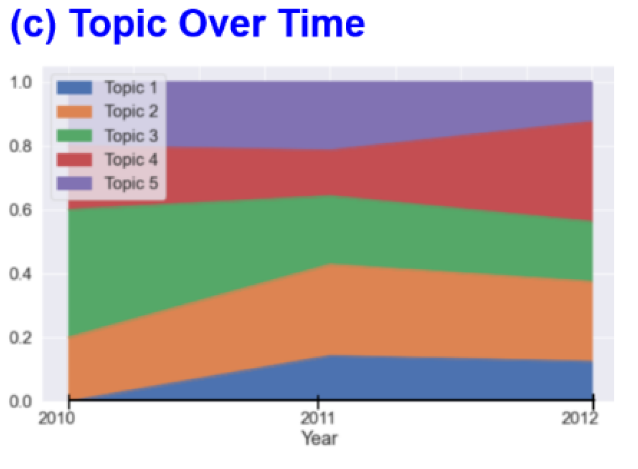
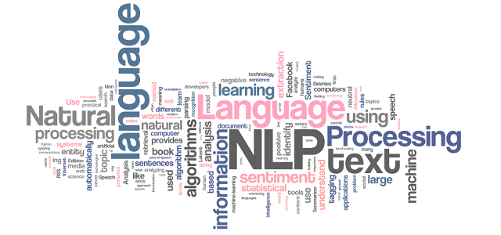
Topic Modeling: Visualizations
Goal would be to include visualizations that:
help users make discoveries more efficiently
make it easier for users to identify new information or areas worthy of exploration
reduce the need for manual review of every topic result
Notes:
http://vis.stanford.edu/papers/termite

Slide 5
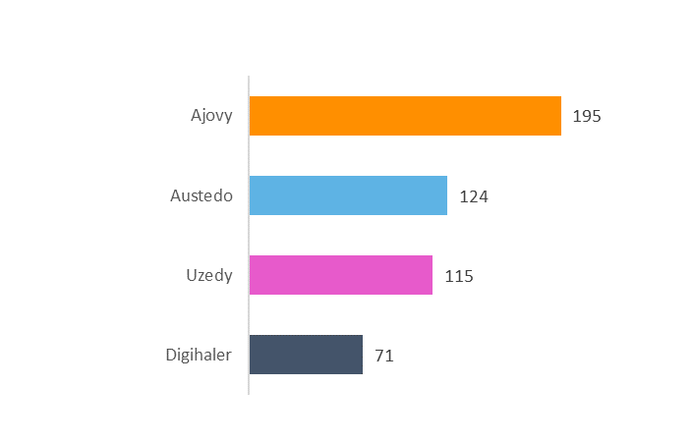
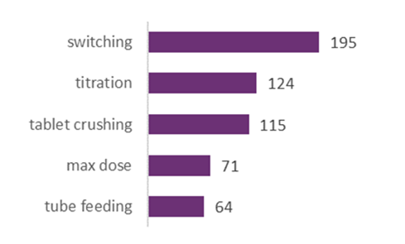
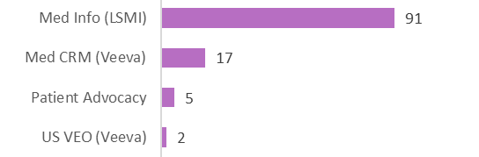
Targeted Search & Tracking: Examples
SEARCH
(users pulling information)
Users can search for a specific topic such as “wearing off effect” and display it for specific products…
AUTOMATIC DISPLAY
(tool pushes information to user)
Automatic display of top 5 topics for Austedo…
Additional functionality for charts:
Because the data populating the charts can come from multiple channels, we want to be able to parse / filter / drill down.
For example, ability to click on the tablet crushing bar and select to view by function, country, region, etc.
View tablet crushing topic by function

Slide 6
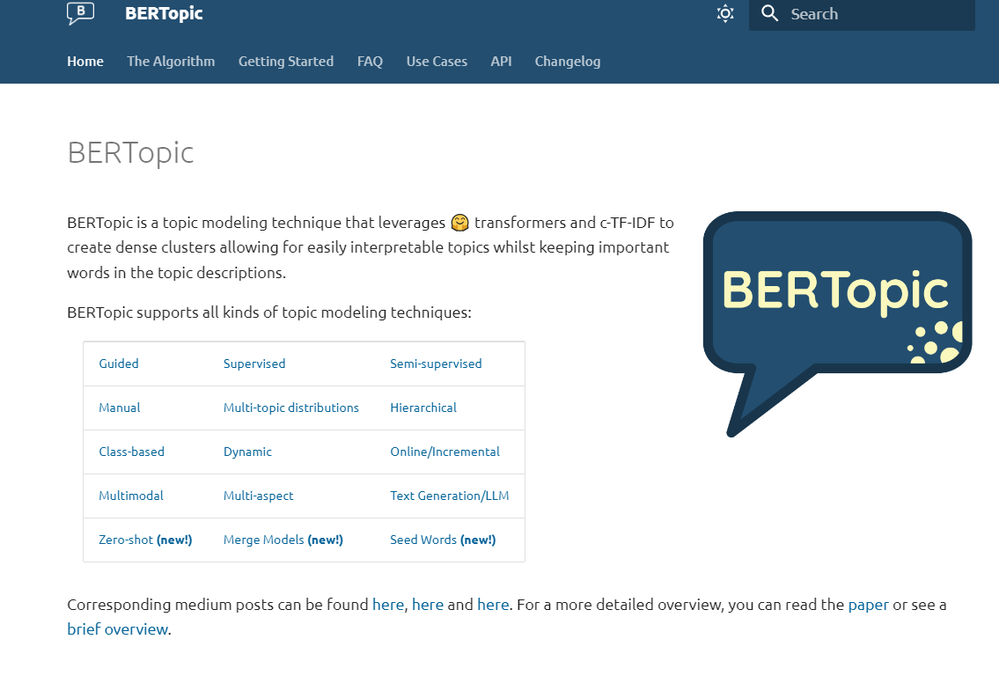
Bertopic

Slide 7
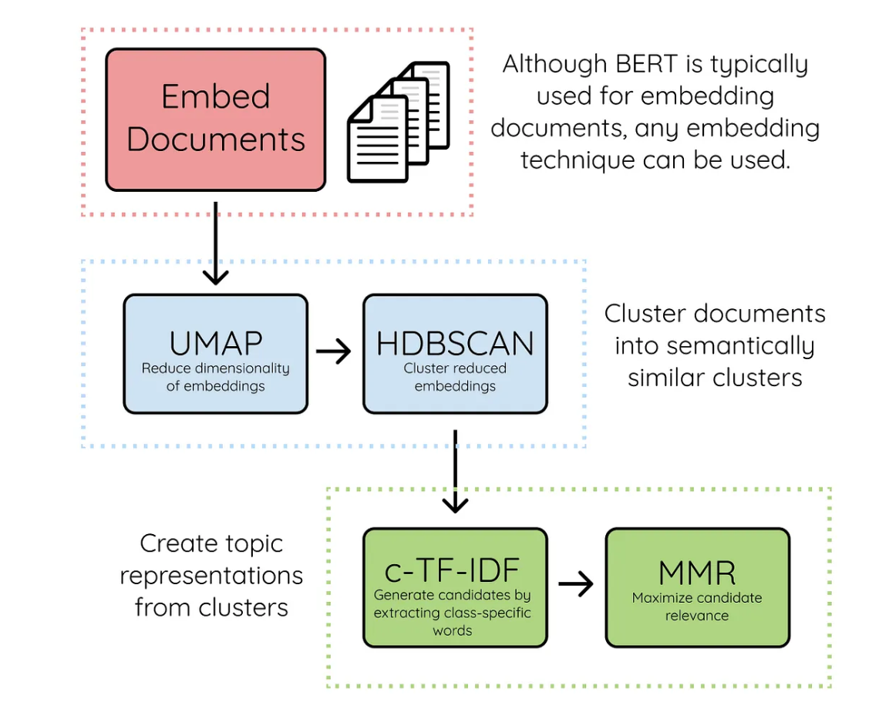
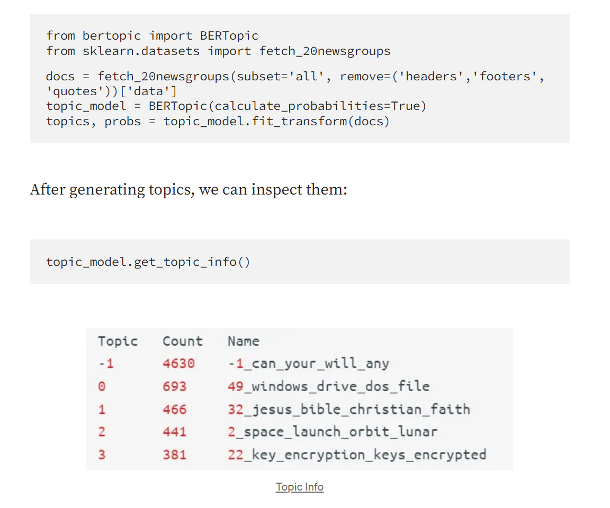
Bertopic algorithm

Slide 8
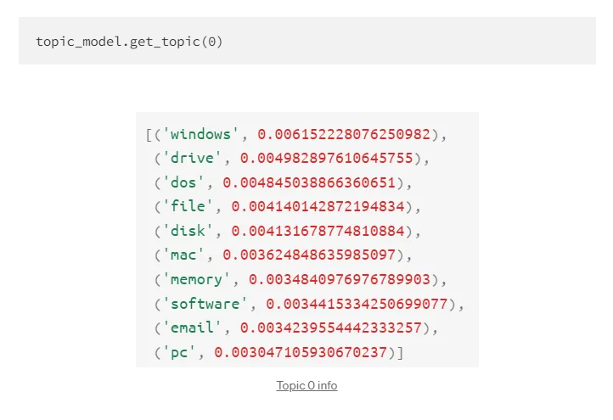
Bertopic algorithm

Slide 9

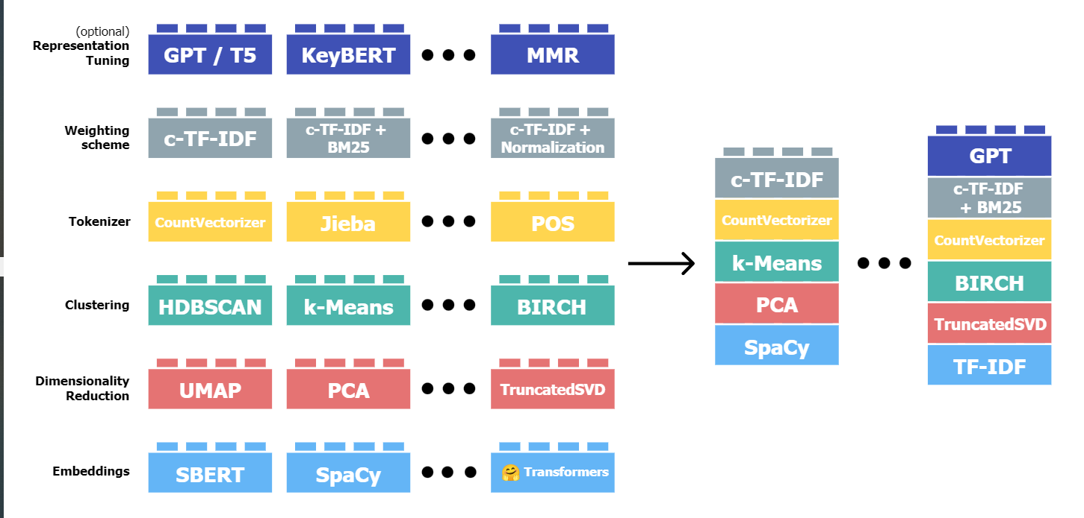
Bertopic algorithm
The various steps can be implemented using different tools
Different pipelines serving the same purpose

Slide 10
UMAP
Why do we need dim reduction?
What other methods do you know?
Task
Given are N points in an M-dimensional space
We want to represent the points into a lower dimensional space K<<M
But we want to preserve the initial ‘structure’ in the data

Slide 11
UMAP
Why do we need dim reduction?
What other methods do you know?
UMAP performs dimensionality reduction
Like PCA, but uses a completely different approach
What is PCA?
PCA vs T-SNE vs. UMAP
https://aurigait.com/blog/blog-easy-explanation-of-dimensionality-reduction-and-techniques/
Criteria to think about when choosing an approach for dim reduction:
Linear vs. Nonlinear
Preservation of global vs. local structure
Computation time and scalability
Interpretability
Suitability for different tasks
Parameter tuning
https://projector.tensorflow.org/ vizualizer
Task
Given are N points in an M-dimensional space
We want to represent the points into a lower dimensional space K<<M
But we want to preserve the initial ‘structure’ in the data

Slide 12
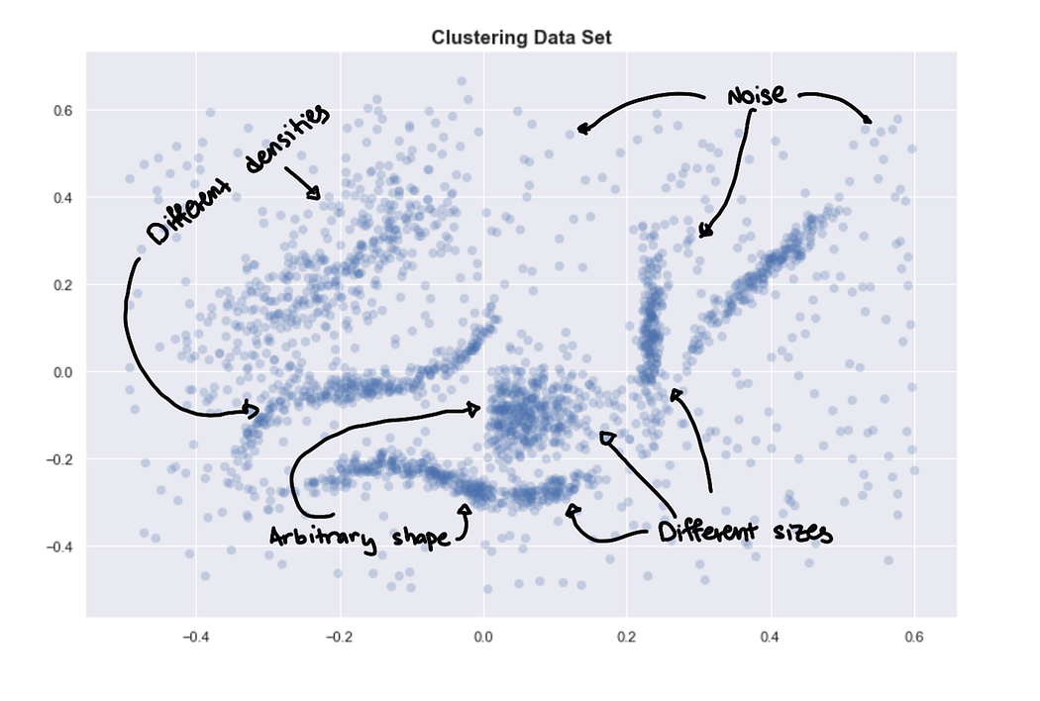
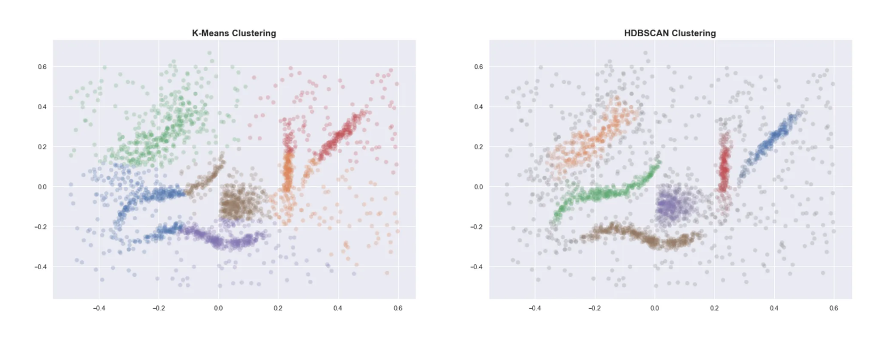
HDBSCAN
What is clustering?
What do we need in order to do clustering of N points in a K-dimensional space?
What are some parameters?
What is a good clustering?

Slide 13
HDBSCAN
Density-based clustering
Efficient computationally
For some usecases it is superior to k-means
Can discover clusters with different densities and shapes
Doesn’t force outliers into clusters

Slide 14
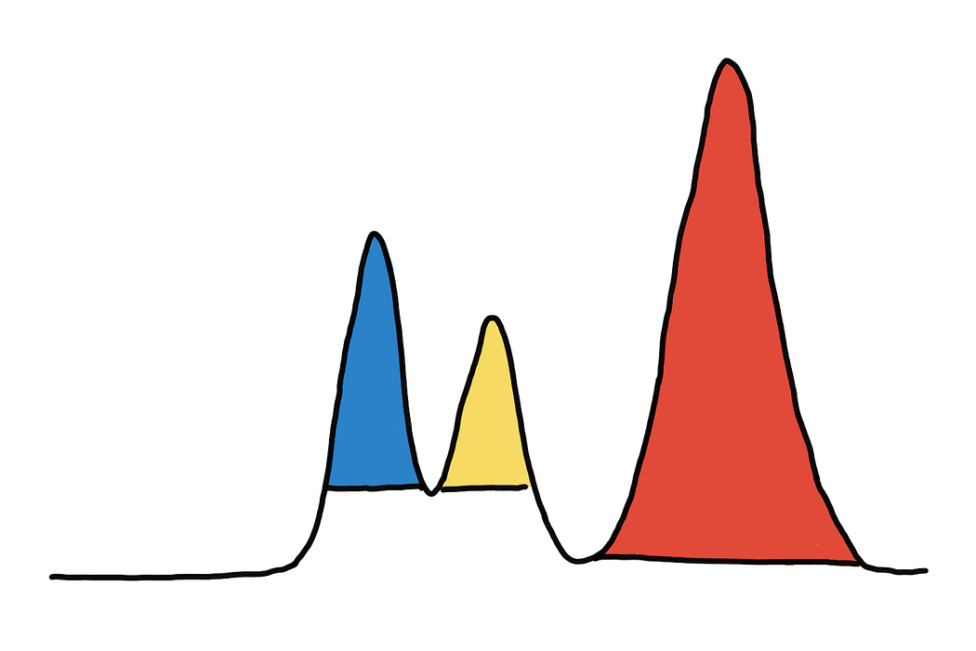
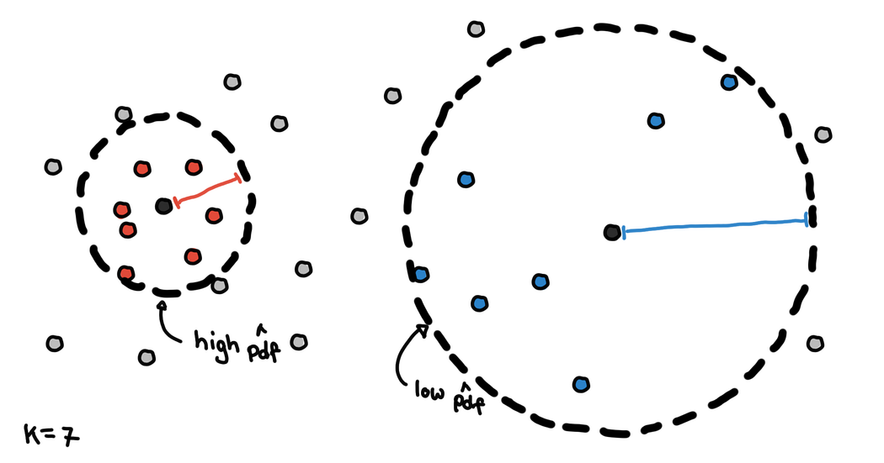
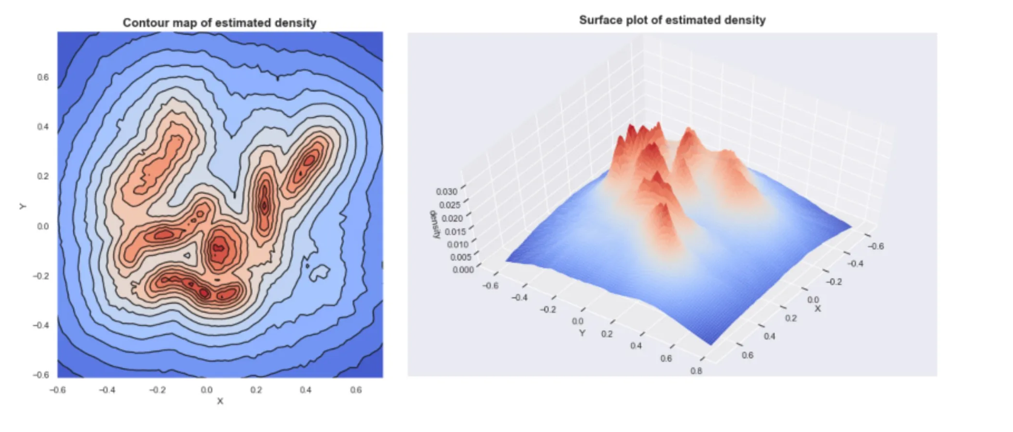
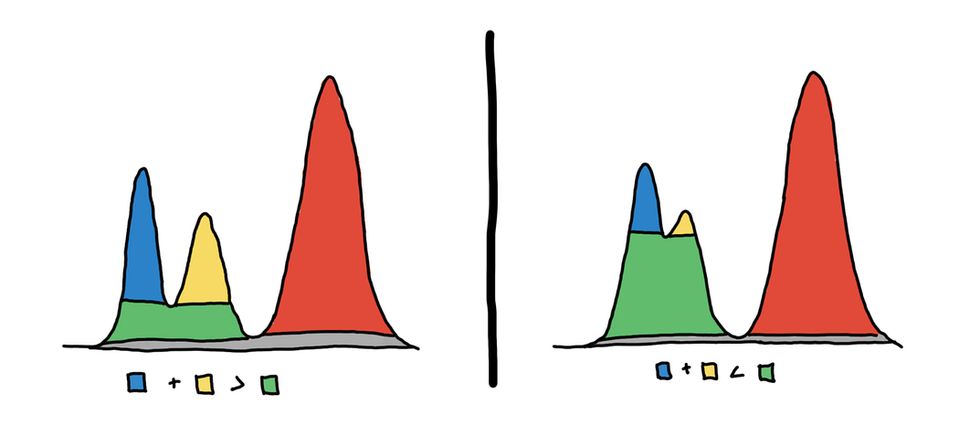
HDBSCAN
Core distance (k)
= distance of a point to its k’th neighbor
Expresses density around point
Using core distance, we get mountains of high-density areas
We need thresholds to guide us where to ‘cut’ and form an island (cluster)
To split or not to split?
Heuristic that compares the size of the base versus the peaks

Slide 15
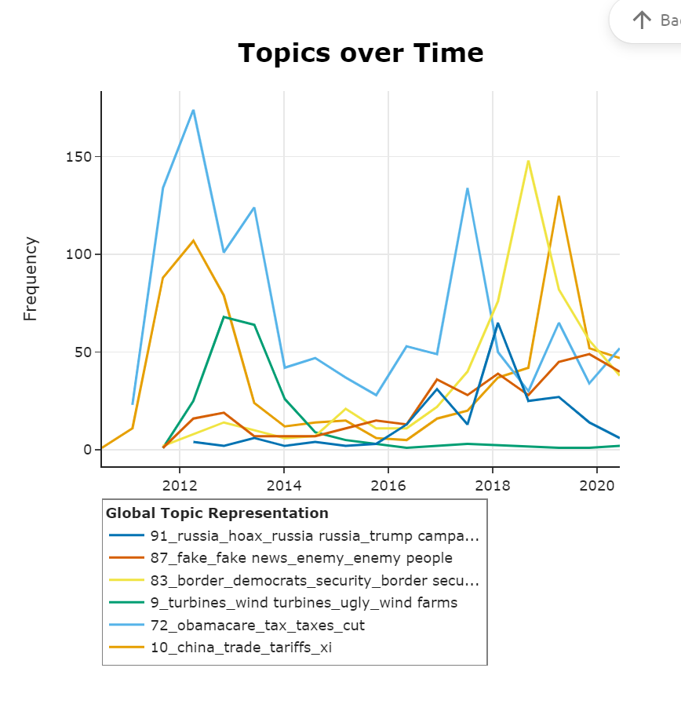
It’s about time
https://maartengr.github.io/BERTopic/getting_started/topicsovertime/topicsovertime.html#visualization
Bertopic can be applied to follow topics over time
This allows integration of text data (news, social media, etc) with other timeseries measurements
Interesting aspects like computational efficiency with high frequency, big data, concept drift, when to retrain, etc
Usecase ideas: <your creativity shows up here>

Slide 16
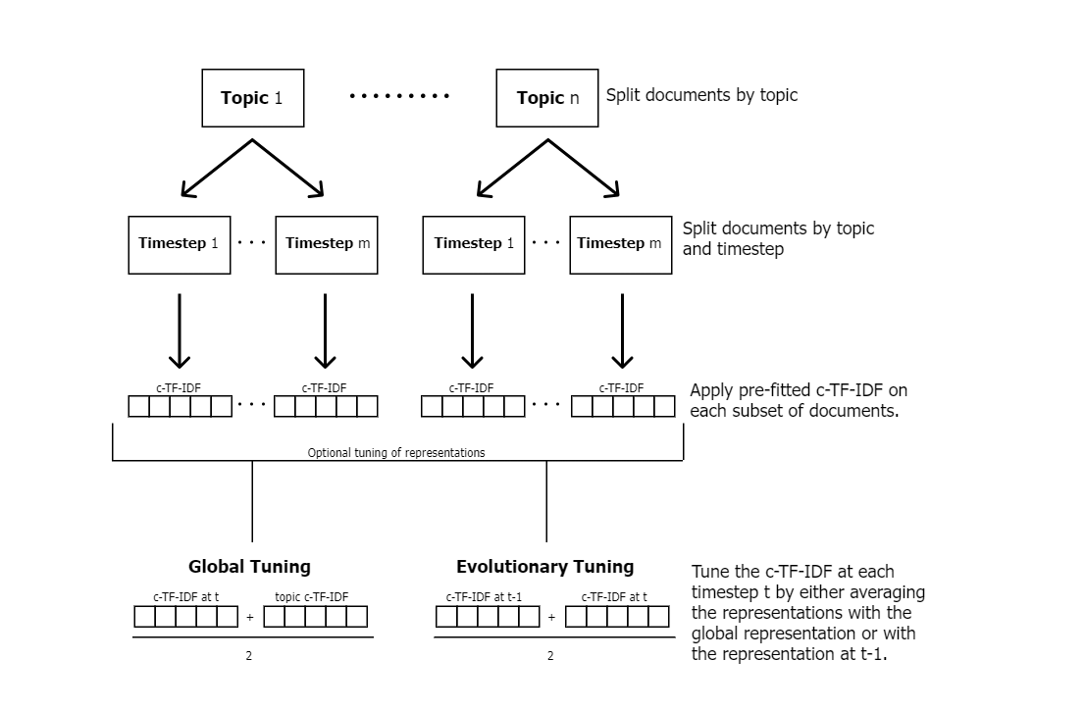
It’s about time

Slide 17
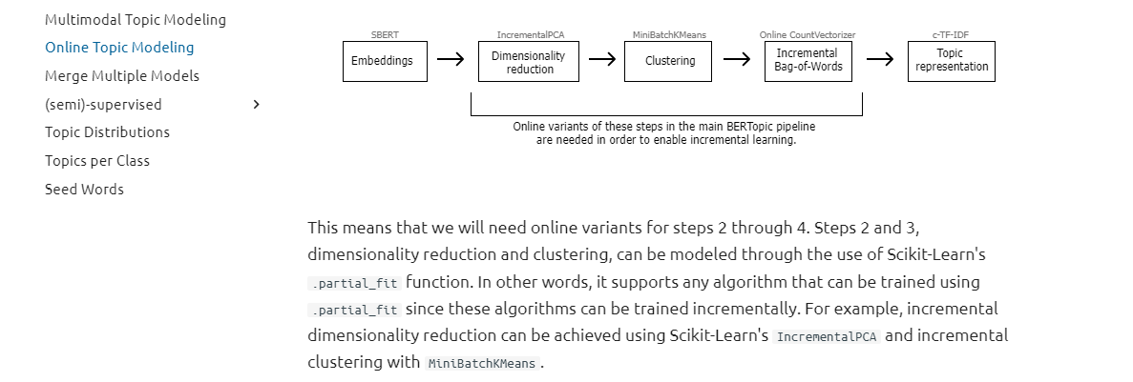
It’s about time
How about updating the topics as time goes?
This is called ONLINE modeling
Look for ONLINE versions for the comonents of your pipeline
Python scikitLearn .partial_fit
Python package River

Slide 18
Conclusion
It’s full of AI tools out there! While listening to this presentation, 100 more appeared probably.
Mix them to create useful applications
KNOW the components!! Study enough Data Science, Math, Linear Algebra, Optimization, Python as to be able to understand what each component does
Then you will be able to choose the right combination and program the solution that is accurate and fast on your data ☺

Slide 19

Q&A

